Slide 1
Agentic AI:Understanding Advanced AI Systems

Slide 2
1 Differentiating Agentic AI from Traditional AI Chains and Workflows

Slide 3
Autonomous agents versus predefined sequential processing in AI
Agentic AI vs. Chains
Understanding Agentic AI
Differentiating AI Architectures
Agentic AI systems exhibit dynamic decision-making and adaptability, contrasting with the fixed, sequential execution of traditional AI chains.
This primer explores the fundamental distinctions between autonomous agents and predefined AI chains, emphasizing their operational differences and applications.
Examining the core architectural differences that enable agents to perform complex tasks, including tool calling and multi-agent coordination.

Slide 4

Dynamic decision-making capabilities of agents compared to static chains
Agentic AI Primer
This section clarifies how agents leverage dynamic decision-making for enhanced performance, a key differentiator from conventional AI chains.
Advanced AI Systems
Exploring the implications of dynamic decision-making in agentic AI for creating more robust and intelligent systems capable of complex tasks.

Slide 5
Adaptive problem-solving through agentic AI architectures
Agents vs. Chains Overview
Understanding Advanced AI
This primer details how agentic AI's architectural design supports more flexible and adaptive problem-solving compared to rigid, sequential chains.
Investigating how agentic AI's adaptive problem-solving capabilities contribute to more intelligent and autonomous systems in various domains.
Agentic Problem-Solving
Agentic AI architectures facilitate adaptive problem-solving by allowing agents to dynamically select tools and strategies to achieve their goals.

Slide 6
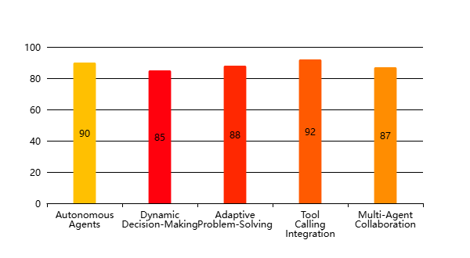
Agentic AI: Agents vs. Chains & Tool Calling
Key Aspects of Agentic AI Architectures(Effectiveness Score (%))

Slide 7
2 Tool Utilization and External Interaction in Agentic Systems

Slide 8

Integrating external tools for enhanced agent functionality and reach
1
Tool Calling: A Key Capability
Examines how agentic AI leverages tool-calling mechanisms to interact with external environments and extend its operational capabilities effectively.
2
External Interaction for Enhanced Reach
Focuses on how agents utilize external tools to expand their reach and influence, interacting with diverse systems and data sources.
3
Agents vs. Chains: Core Differences
This section explores the fundamental distinctions between agentic AI systems and traditional AI chains, highlighting their architectural and operational variances.

Slide 9
Leveraging APIs and databases for real-time information access
API and Database Integration
Agents vs. Chains: Data Access
Focuses on the practical aspects of integrating APIs and databases to provide agents with real-time information, enhancing their responsiveness and accuracy.
Compares how agentic AI and AI chains approach real-time data access, emphasizing the dynamic nature of agent interactions with information sources.
Tool Calling for Data Retrieval
Details the process of using tool-calling to access and retrieve real-time information from APIs and databases, crucial for informed decision-making.

Slide 10

Orchestrating complex tasks through effective tool-calling mechanisms
Agents vs. Chains: Task Orchestration
Analyzes how agentic AI systems and AI chains differ in their ability to orchestrate complex tasks, highlighting the adaptive nature of agents.

Slide 11
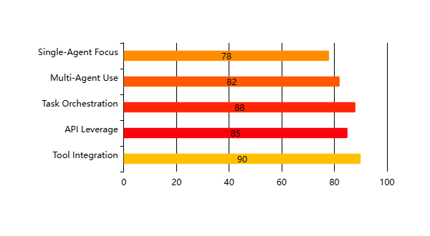
Agentic AI Capabilities Overview
Key Aspects of Agentic AI Implementation(Effectiveness Score (%))

Slide 12
Thank You

